Slide 1
Adventures Works Project

Slide 2
Today’s Agenda
Group Members Name
Summary Of the Project
KPI List
Excel Dashboard
Power BI Dashboard
Tableau Dashboard
SQL
Suggestions
Key Take Away

Slide 3
Group Members
A Sravani
Ravella Pavansai
Sahil Patil
Shruti Tushar Bhavsar

Slide 4

Project Summary
Developed an interactive dashboard using Excel, PowerBi, SQL and Tableau to analyze sales, profit, products, customers, and regional performance.
Tracked key KPIs including Sales (29.36M), Profit (12.08M), Orders (60,398), and Average Order Value (486.09).
Performed Top 5 & Top 10 analysis to identify best-performing products, customers, sales representatives, and territories.
Identified Mountain-200 series as the top-selling products and Bikes as the highest-performing category.
Analyzed country-wise, region-wise, and time-based sales trends to understand business growth and market performance.
Compared sales and production costs to evaluate profitability and operational efficiency.
Used interactive filters for Year, Country, Category, Region, and Sub-Category to enable dynamic analysis.

Slide 5

KPI List
KPI 1: Total Sales Amount
KPI 2: Total Production Cost
KPI 3: Total Profit
KPI 4: Total Order Quantity
KPI 5: Product-wise Performance
KPI 6: Customer-wise Performance
KPI 7: Region-wise Performance
KPI 8: Month-wise Sales Trend
KPI 9: Year-wise Sales Growth
KPI 10: Sales vs Production Cost

Slide 6

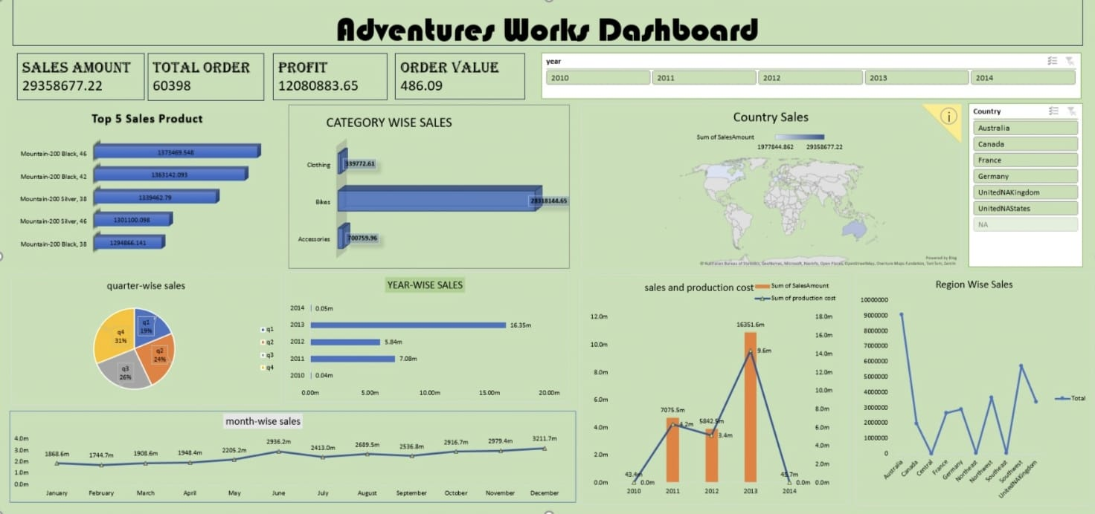
Excel Dashboard

Slide 7
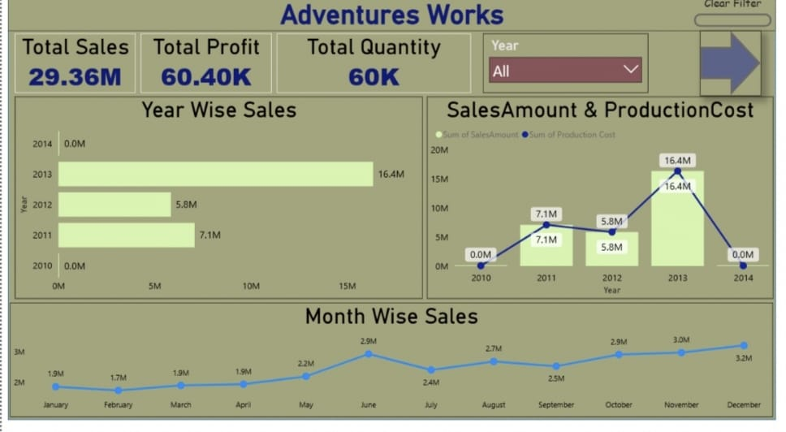
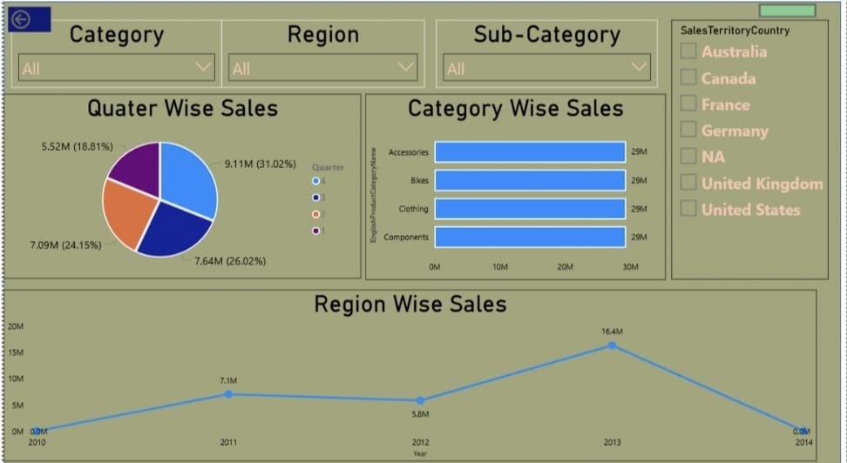
PowerBi Dashboard

Slide 8
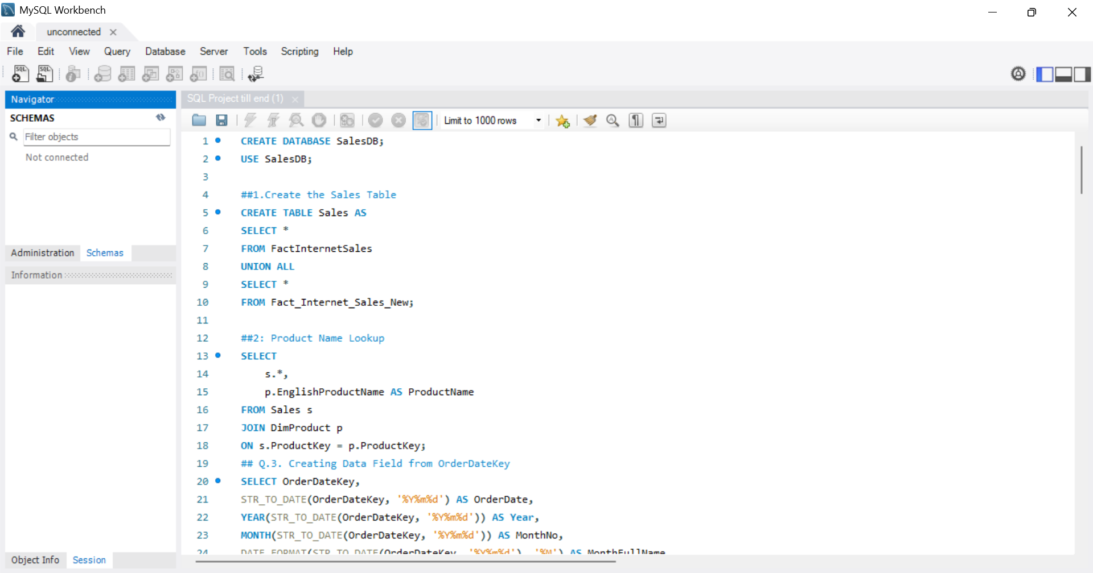
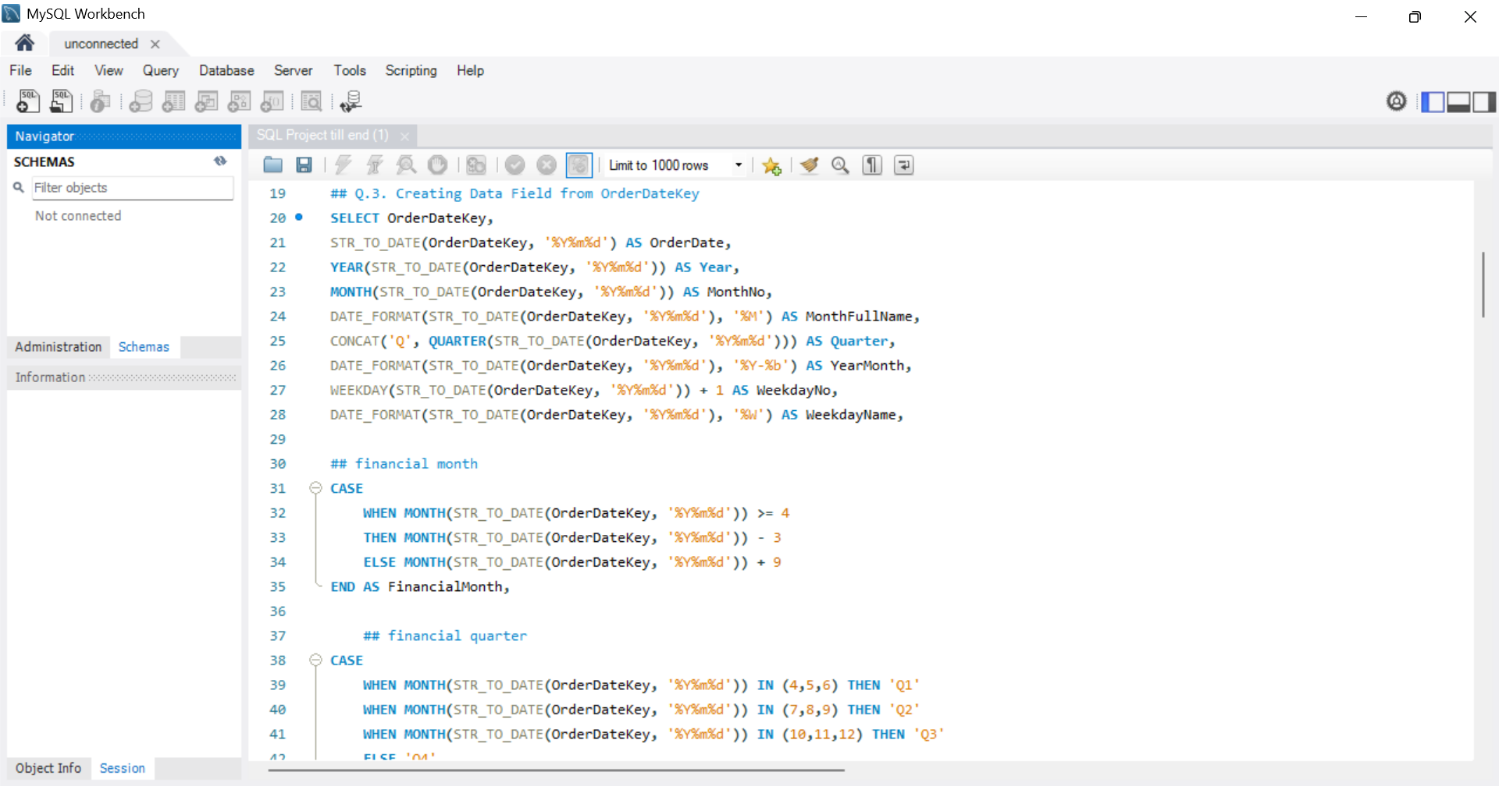
Sql script

Slide 9
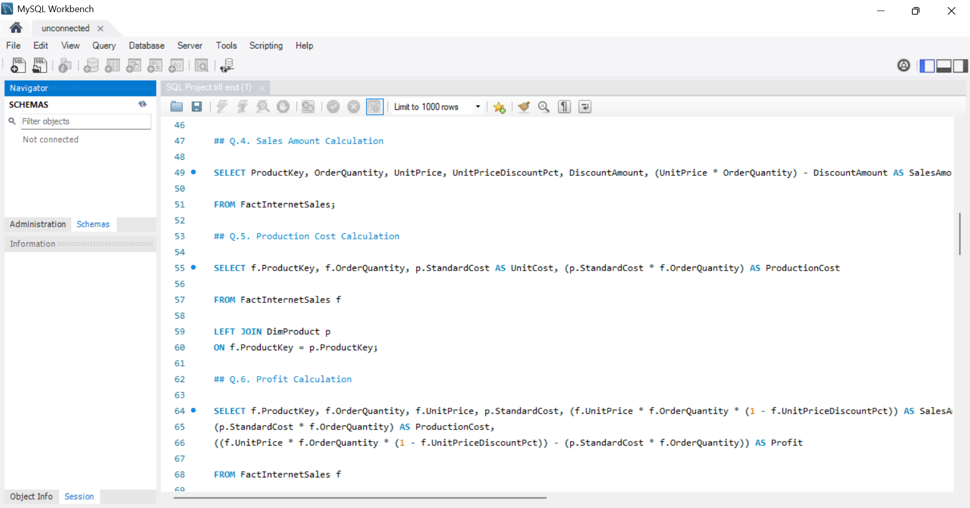
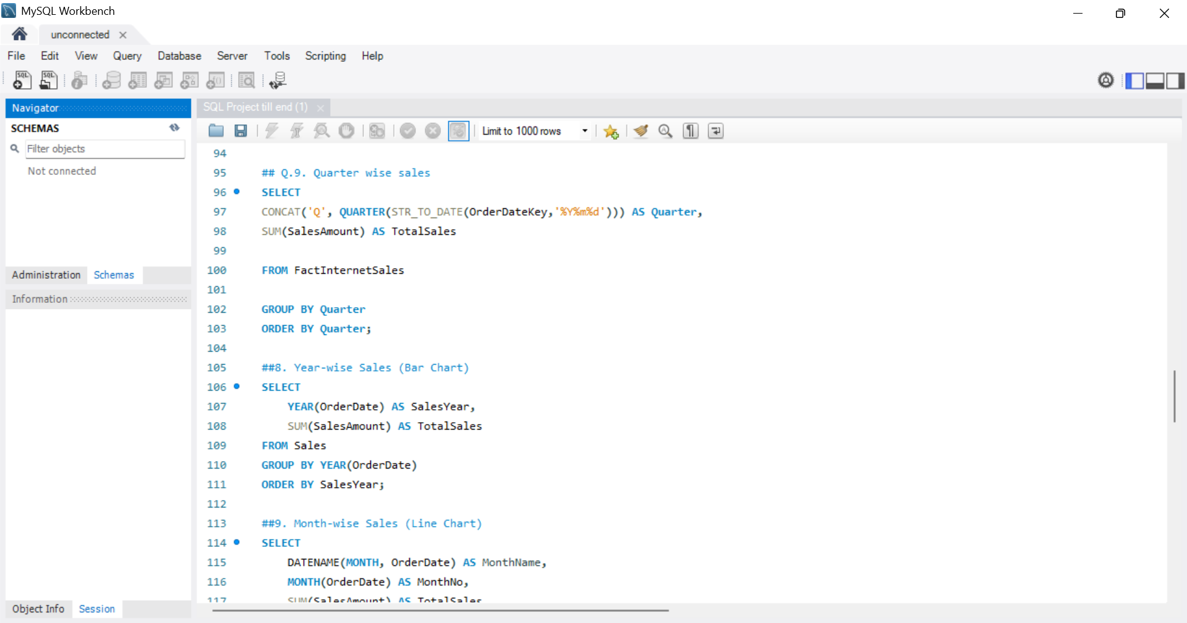
Sql script

Slide 10
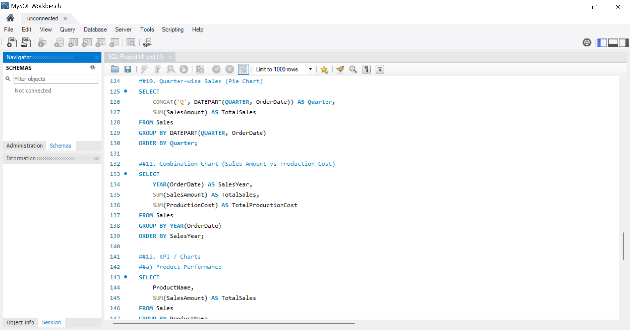
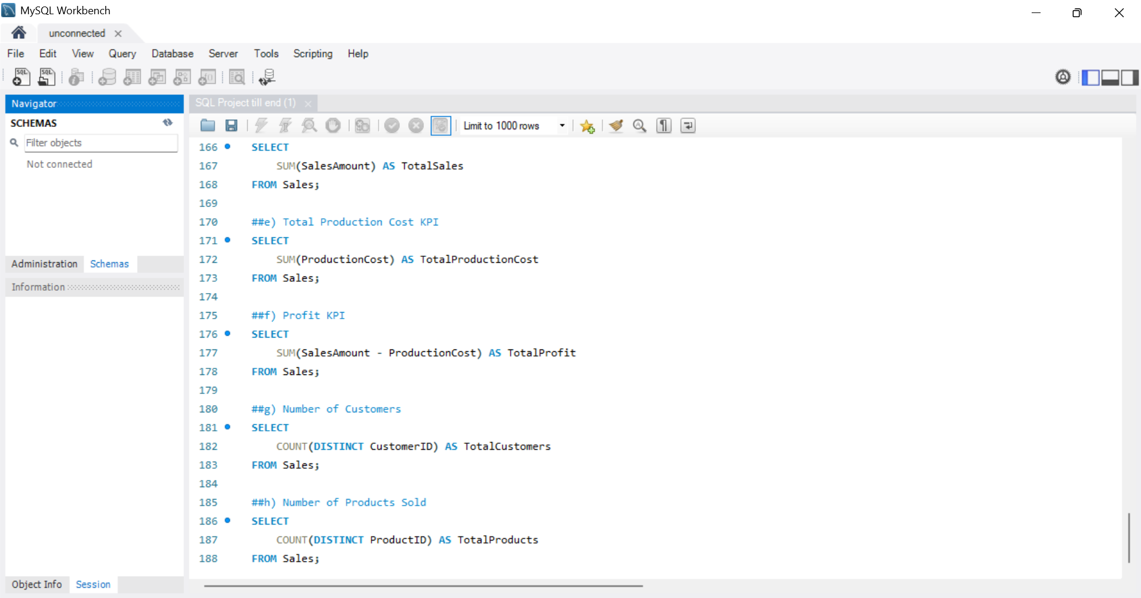
Sql script

Slide 11
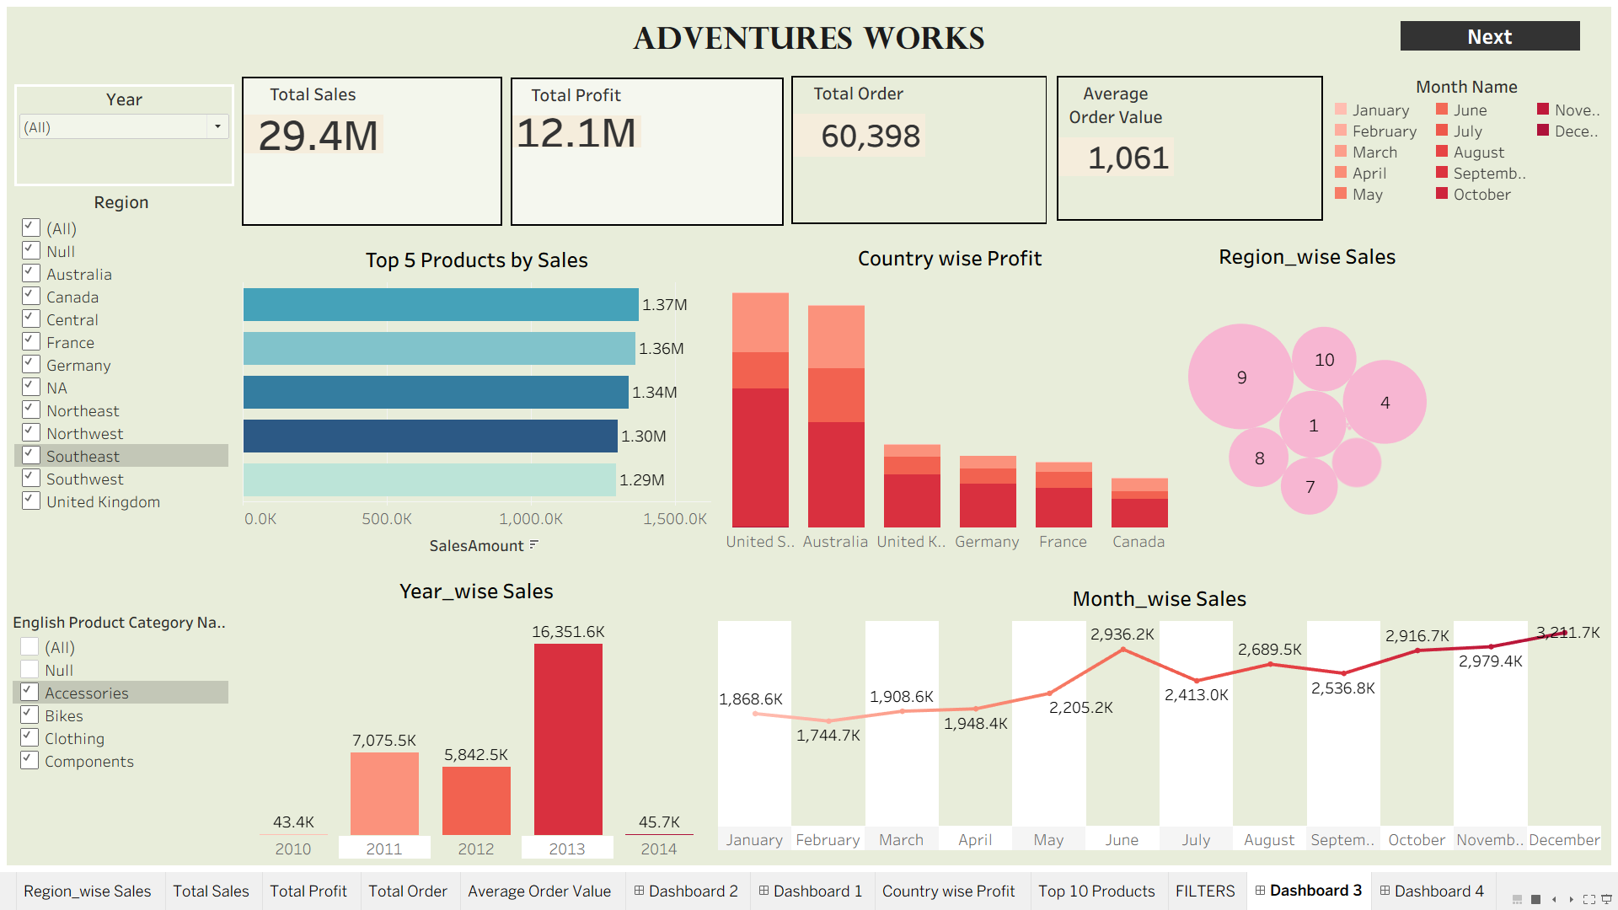
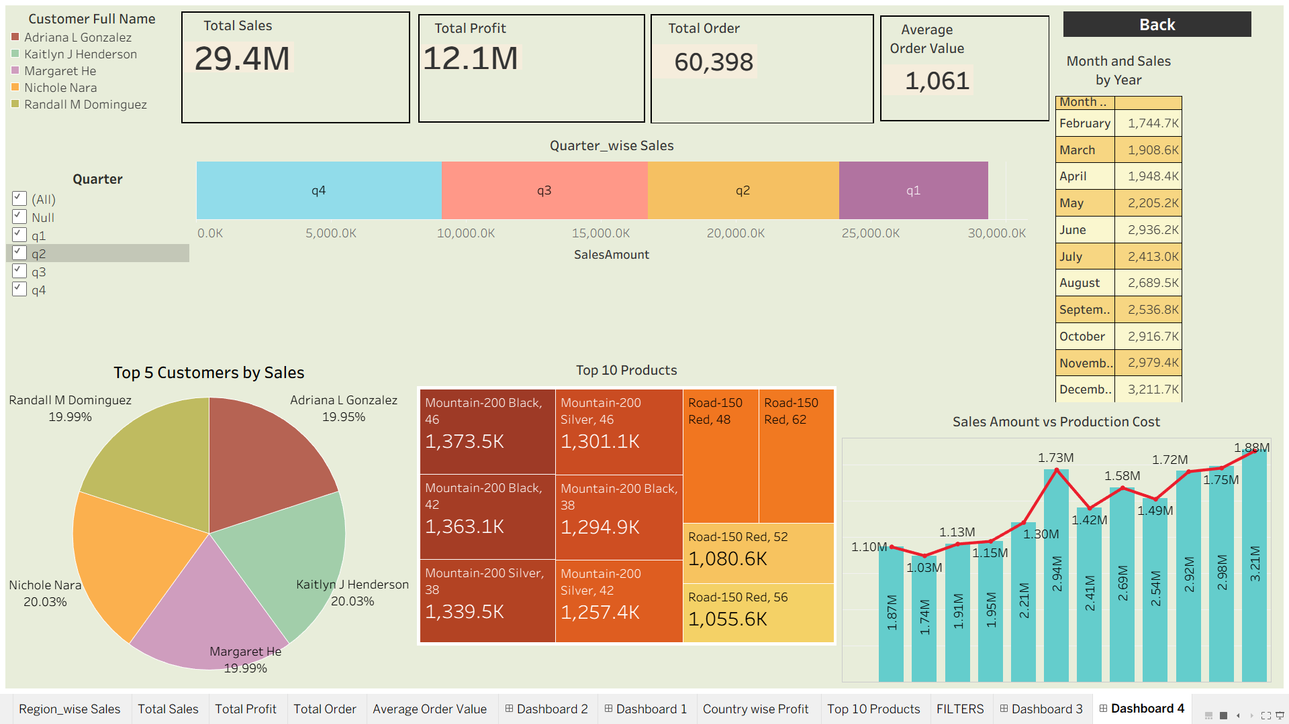
Tableau Dashboard

Slide 12
Key Takeaways
Sales performance varies across regions, highlighting opportunities for market expansion.
A small number of products generate the highest sales and profit. Production costs directly impact overall profitability.
Order quantity trends help improve inventory planning and demand forecasting.
Regular KPI monitoring enables faster and more effective business decisions.
Data-driven insights support business growth and operational efficiency.

Slide 13
Suggestions
Monitor Total Sales Amount: Track sales monthly, quarterly, and yearly to identify growth trends, seasonal patterns, and improvement opportunities.
1
Control Total Production Cost: Compare production costs with sales to reduce expenses and improve operational efficiency.
2
Increase Total Profit: Analyze profit trends to ensure sales growth leads to higher profitability and better financial performance.
3
Optimize Order Quantity: Monitor order volumes to understand customer demand and support effective inventory management.
4
Improve Product-wise Performance: Focus on high-performing products and develop strategies to enhance sales and profitability of low-performing products.
5

Slide 14
Thank You

